Slide 1





Senior Design
Autonote: Transformative meeting summarization and highlighting points based on NLP
Group Members
Sheikh Mohammed Wali Ullah
2021186042
Md Saiyem Raiyan
2012468042
Samia Sultana
2014048042
Zobaer Ahammod Zamil
2021796042

Slide 2

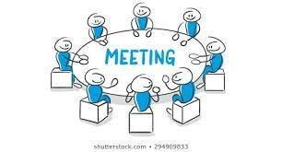
Problem Statement
Problem
NLP
In modern workplaces, meetings are essential for collaboration and decision-making. Automatic meeting summarization, powered by Natural Language Processing (NLP), aims to address this challenge by distilling key meeting insights into concise summaries. Sometimes we miss meetings that are happening online due to some unavoidable circumstances. Again, sometimes we miss out on some important points of the meeting because of various reasons. However, before our important work or study time is very crucial so we need to do it in a faster or optimal way. That’s why we need to summarize a long meeting so that we can be able to understand easily and a faster way within our due time. Therefore, a gist of an online meeting is often very important to those who missed it or those who try to recall it. There can be a system which can make a summary of a meeting while it is running online.
What NLP doing?
System ability?
Generated Summary
Basically, this NLP summerizing develops a system that can automatically generate accurate and informative summaries of meetings.
Given a transcript of a meeting, the system should be able to identify the most important topics, extract key points, decisions, action items, discussions, and present them in a coherent and concise manner.
Introducing a revolutionary concept: a dynamic system that crafts comprehensive summaries of online meetings as they unfold. The generated summary should capture the essence of the meeting while filtering out redundant or less relevant information.

Slide 3
Related Works
Title: DIALOGLM: Pre-trained Model for Long Dialogue Understanding and Summarization
Title: NLP Based Text Summarization Using Semantic Analysis
Authors: Hamza Shabbir Moiyadi, Harsh Desai, Dhairya Pawar, Geet Agrawal, Nilesh M.Patil
Authors: Ming Zhong, Yang Liu, Yichong Xu, Chenguang Zhu, Michael Zeng
Idea: In this paper we got an idea about converting the long text into a short summary in case of a conversation. Using NLP and the concept of summarization they are converting a speech which is long to a short summary.
Idea: This paper gives ideas about reducing physical workload for identifying important ideas from a document. Using NLP it can extract representative sentences from documents. It takes a document as an input. Summarizing of domain specific text by using semantic analysis for this text summarization.
Title: A Survey on NLP based Text Summarization for Summarizing Product Reviews"
Title: Trainable, Scalable Summarization Using Robust NLP and Machine Learning
Authors: Ravali Boorugu, Dr. G. Ramesh (2020)
Idea: This paper is about how to detect which products are genuine and pick the best among the unlimited options at the same price. As everyone wishes to get their products delivered to their home without any hassle and looks at the reviews before ordering anything online.
Authors: Chinatsu Aone, Mary Ellen Okurowski, James Gorlinsky
Idea: This paper gives ideas about using NLP techniques it will summarize the best combination of the features and shows the report based on system scalability.

Slide 4
Related Works
Title: Abstractive Meeting Summarization with Entailment and Fusion
Title: Summarizing Spoken and Written Conversations
Authors: Yashar Mehdad, Giuseppe Carenini, Frank W. Tompa, Raymond T. NG
Idea: This paper shows the idea of using tokenization in summarization. Using word ranking it can express longer conversations into effective summarization while following the appropriate grammar.
Authors: Gabriel Murray and Giuseppe Carenini
Idea: This paper is about a conversation summarization system that appears to discuss a conversation summarization system that is designed to work across various domains. The system likely utilizes general conversational features to generate summaries of both spoken and written conversations and compare the results of their system with domain-dependent systems that were developed specifically for meeting and email data. This paper could provide insights into how conversation summarization techniques can be applied effectively in different contexts and may explore the strengths and limitations of using a domain-independent approach compared to domain-specific systems.
Title: Model: T5 Tokenizer
Idea: It is a text-to-text transformer model, which can handle various natural language processing tasks by framing them as text-to-text tasks, where both input and output are texted sequences. It tokenize the input, add special tokens, etc. T5's flexibility and transfer learning capabilities enable it to achieve state-of-the-art results across multiple domains.

Slide 5
A Working Plan
Week 1 | Project Idea
Week 2 | Project Idea
Week 3 | Project Idea
Week 4 | Project Idea
Week 5 | Analysis + Related Works
Week 6 | Analysis + Related Works
Week 7 | Analysis + Related Works
Week 8 | Project Design
Week 9 | Project Design
Week 10 | Project Design
Week 11 | Ethical and professional responsibility
Week 12 | Social, Environmental effects
Week 13 | Final demo
Week 14 | Final presentation
Week 15 | Final report
Responsibility and effects
Project Design
Project Idea
Analysis + Related Works

Slide 6
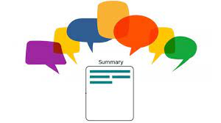
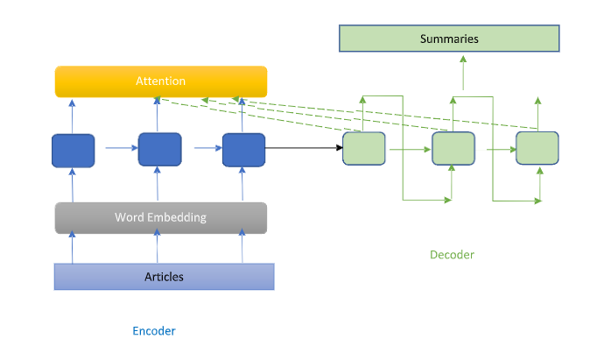
THANK YOU

